Slide 1
Welcome to Ms. Hough’s
Curriculum Night
2nd Grade
Patterson Elementary
2022 - 23
hough.mary@cusd80.com

Slide 2
Communication
Open Door Policy… be sure to keep in touch! We are partners this year.
White binder goes back and forth each day
A newsletter emailed each week
Conferences are held in August and February
this year.
Please allow 24 hours for a response from me to e-mails/voicemails
Email is the best way to contact me: hough.mary@cusd80.com

Slide 3
Absences
Attendance is important in second grade.
All missed work will be sent home when the child returns.
The student has the same number of days they were absent to make up the work.
I do not send work home prior to absences.
Missed math tests will be made up upon return.
Missed ELA tests are not made up but do not count against their grade.
Please call in absences to the front office for the absence to be excused.

Slide 4
Grades and
Report Cards
Percentage Grades
Progress reports will be available on Infinite Campus halfway through the quarter
Report cards can be accessed on Infinite Campus
Parent teacher conferences in Fall and Spring

Slide 5
Homework
Packets go home on Mondays
English/Language Arts, Spelling every day
Math homework from textbook most nights
Fluency Passage nightly
Read for 20 minutes nightly and record
Practice Math Facts – 5 minutes
Parent signature needed
Due on Friday – If late or missing loss of a “Fun Friday” letter and goes Quiet Room to work on homework
Please do not un-staple the homework packet

Slide 6
Discipline/Accountability Plan
Students follow Six Pillars (Respect, Responsibility, Caring, Fairness, Trustworthiness, Citizenship) and Classroom Rules
Be Kind Schoolwide Program
Positive behavior is rewarded through punch cards and class “moolah”.
Consequences for not following the rules include: Warnings, Missed Recess, Lost “Fun Friday” letters, Detention, School Wide Discipline Plan
Quiet Room on Fridays– (No homework, incomplete work, behavior)

Slide 7
Fun Friday Cards & Class Moolah
Students receive a new “FUN FRIDAY” card at the start of each week (strip of paper with the words Fun Friday written on it)
Students maintain FUN FRIDAY letters provided they display positive behavior and responsibility on a daily basis
Students will lose letters (I cross off one at a time) if they choose to not follow classroom rules. Examples include:
Late/No Homework
Not following 6-character pillars
Talking in the hallway
Off task
Classroom disruption
Talking while I am teaching
Unkind or disrespectful
Blurting

Slide 8
Punch cards
Positive behavior is encouraged and rewarded through individual punch cards given to each student
Students earn “punches” for positive behavior noticed by teacher. Examples include:
Homework
Demonstrating 6 Pillars
Participating
Working Quietly
On Task
Following Directions
Being Kind – helping others
Upon filling up their punch card, students choose from a variety of rewards (lunch with teacher, homework pass, gum for a day, etc.)

Slide 9
Language Arts
Reading - Journeys (Think Central)
Whole Group, Small Group, Centers
Apply phonetic decoding strategies
Activate prior knowledge
Use strategies to develop meaning
Apply a variety of reading comprehension strategies
Create daily reading opportunities
Accelerated Reader (Incentives and awards)
Fridays are testing days for Language Arts. We will have a spelling, vocabulary, grammar, phonics and comprehension test every Friday.

Slide 10
Language Arts (cont’d.)
Writing Process
Personal Narratives
Journals
Creative Stories
Friendly Letters
Informational Report
Thinking Maps
School-wide program
A visual language tool for learning within and
across disciplines
Corresponds with eight fundamental thinking
processes

Slide 11
Math
My Math
- Daily math facts practice at home is key
- Data Analysis
- Addition and Subtraction with Regrouping
- Measurement (length, time, temperature)
- Place Value
- Problem Solving
- Money
- Rocket Math
- Word Problems

Slide 12
Science/Social Science
Aligned to New State Standards
Science**
- Matter, Landforms and Bodies of Water, Weather and Natural Events
Social Studies**
- Civics/Communities, Geography/Maps, Economics: Wants and Needs, Cultures around the world
**Many of the units are integrated and will be taught at the same time
SEL (Social Emotional Learning)
- Second Step Curriculum and activities

Slide 13
Fun Friday Cards & Class Moolah
(cont’d.)
Students will receive class “moolah” for FUN FRIDAY letters kept each week which may be used at the end of the quarter Pride Party​
At the end of each quarter, students will be able to participate in the end of the quarter Pride Party

Slide 14
Specials
Day 1 Music
Day 2 Tech Lab
Day 3 P.E.
Day 4 Music
Day 5 Library
Day 6 P.E.
Sneakers on PE days

Slide 15
Birthdays!
All treats must be store bought and prepackaged. They should be dropped off at the office or sent in with your child.
NO CUPCAKES, CAKE or DONUTS
Birthday invitations are not allowed to be handed out at school unless the whole class is invited.
Birthday deliveries (i.e. balloons) are not permitted in the classroom.

Slide 16
How Can I help Patterson?

Slide 18
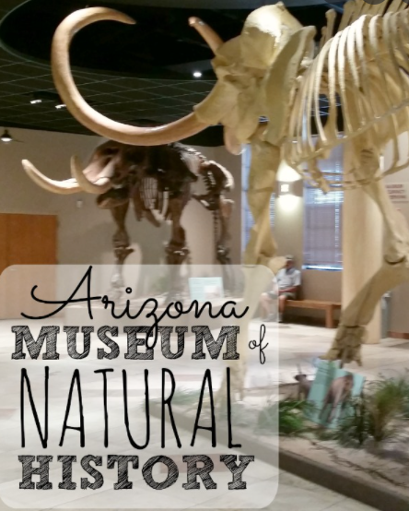
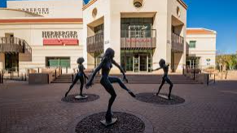
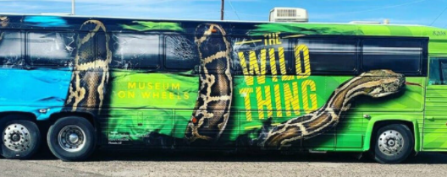
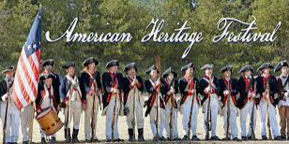
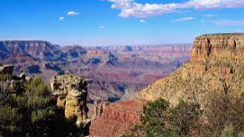
Each grade level organizes fieldtrips to enrich students’ education.
Past experiences have included:
The Wild Thing Bus
6th Grade Science Camp
Phoenix Zoo
Skateland (STEM projects)
American Heritage Festival/We Make History
Grand Canyon
Sonoran Desert Museum
Phoenix Symphony
Herberger Theater
AZ Natural History Museum
AZ Science Museum

Slide 19
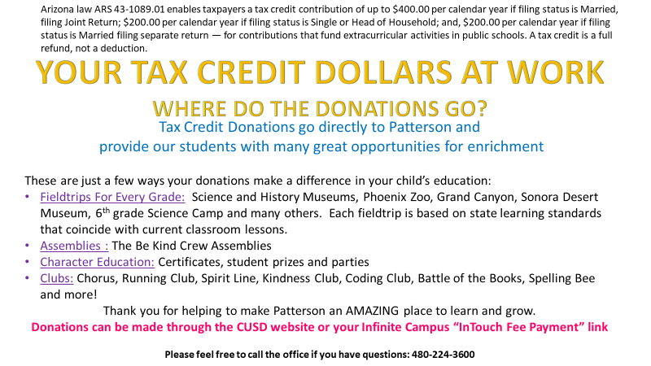

Slide 20
Classroom
Donations
I will send an email out when I need donations for the classroom. You may also receive a sign up to donate for classroom parties or special activities.

Slide 21
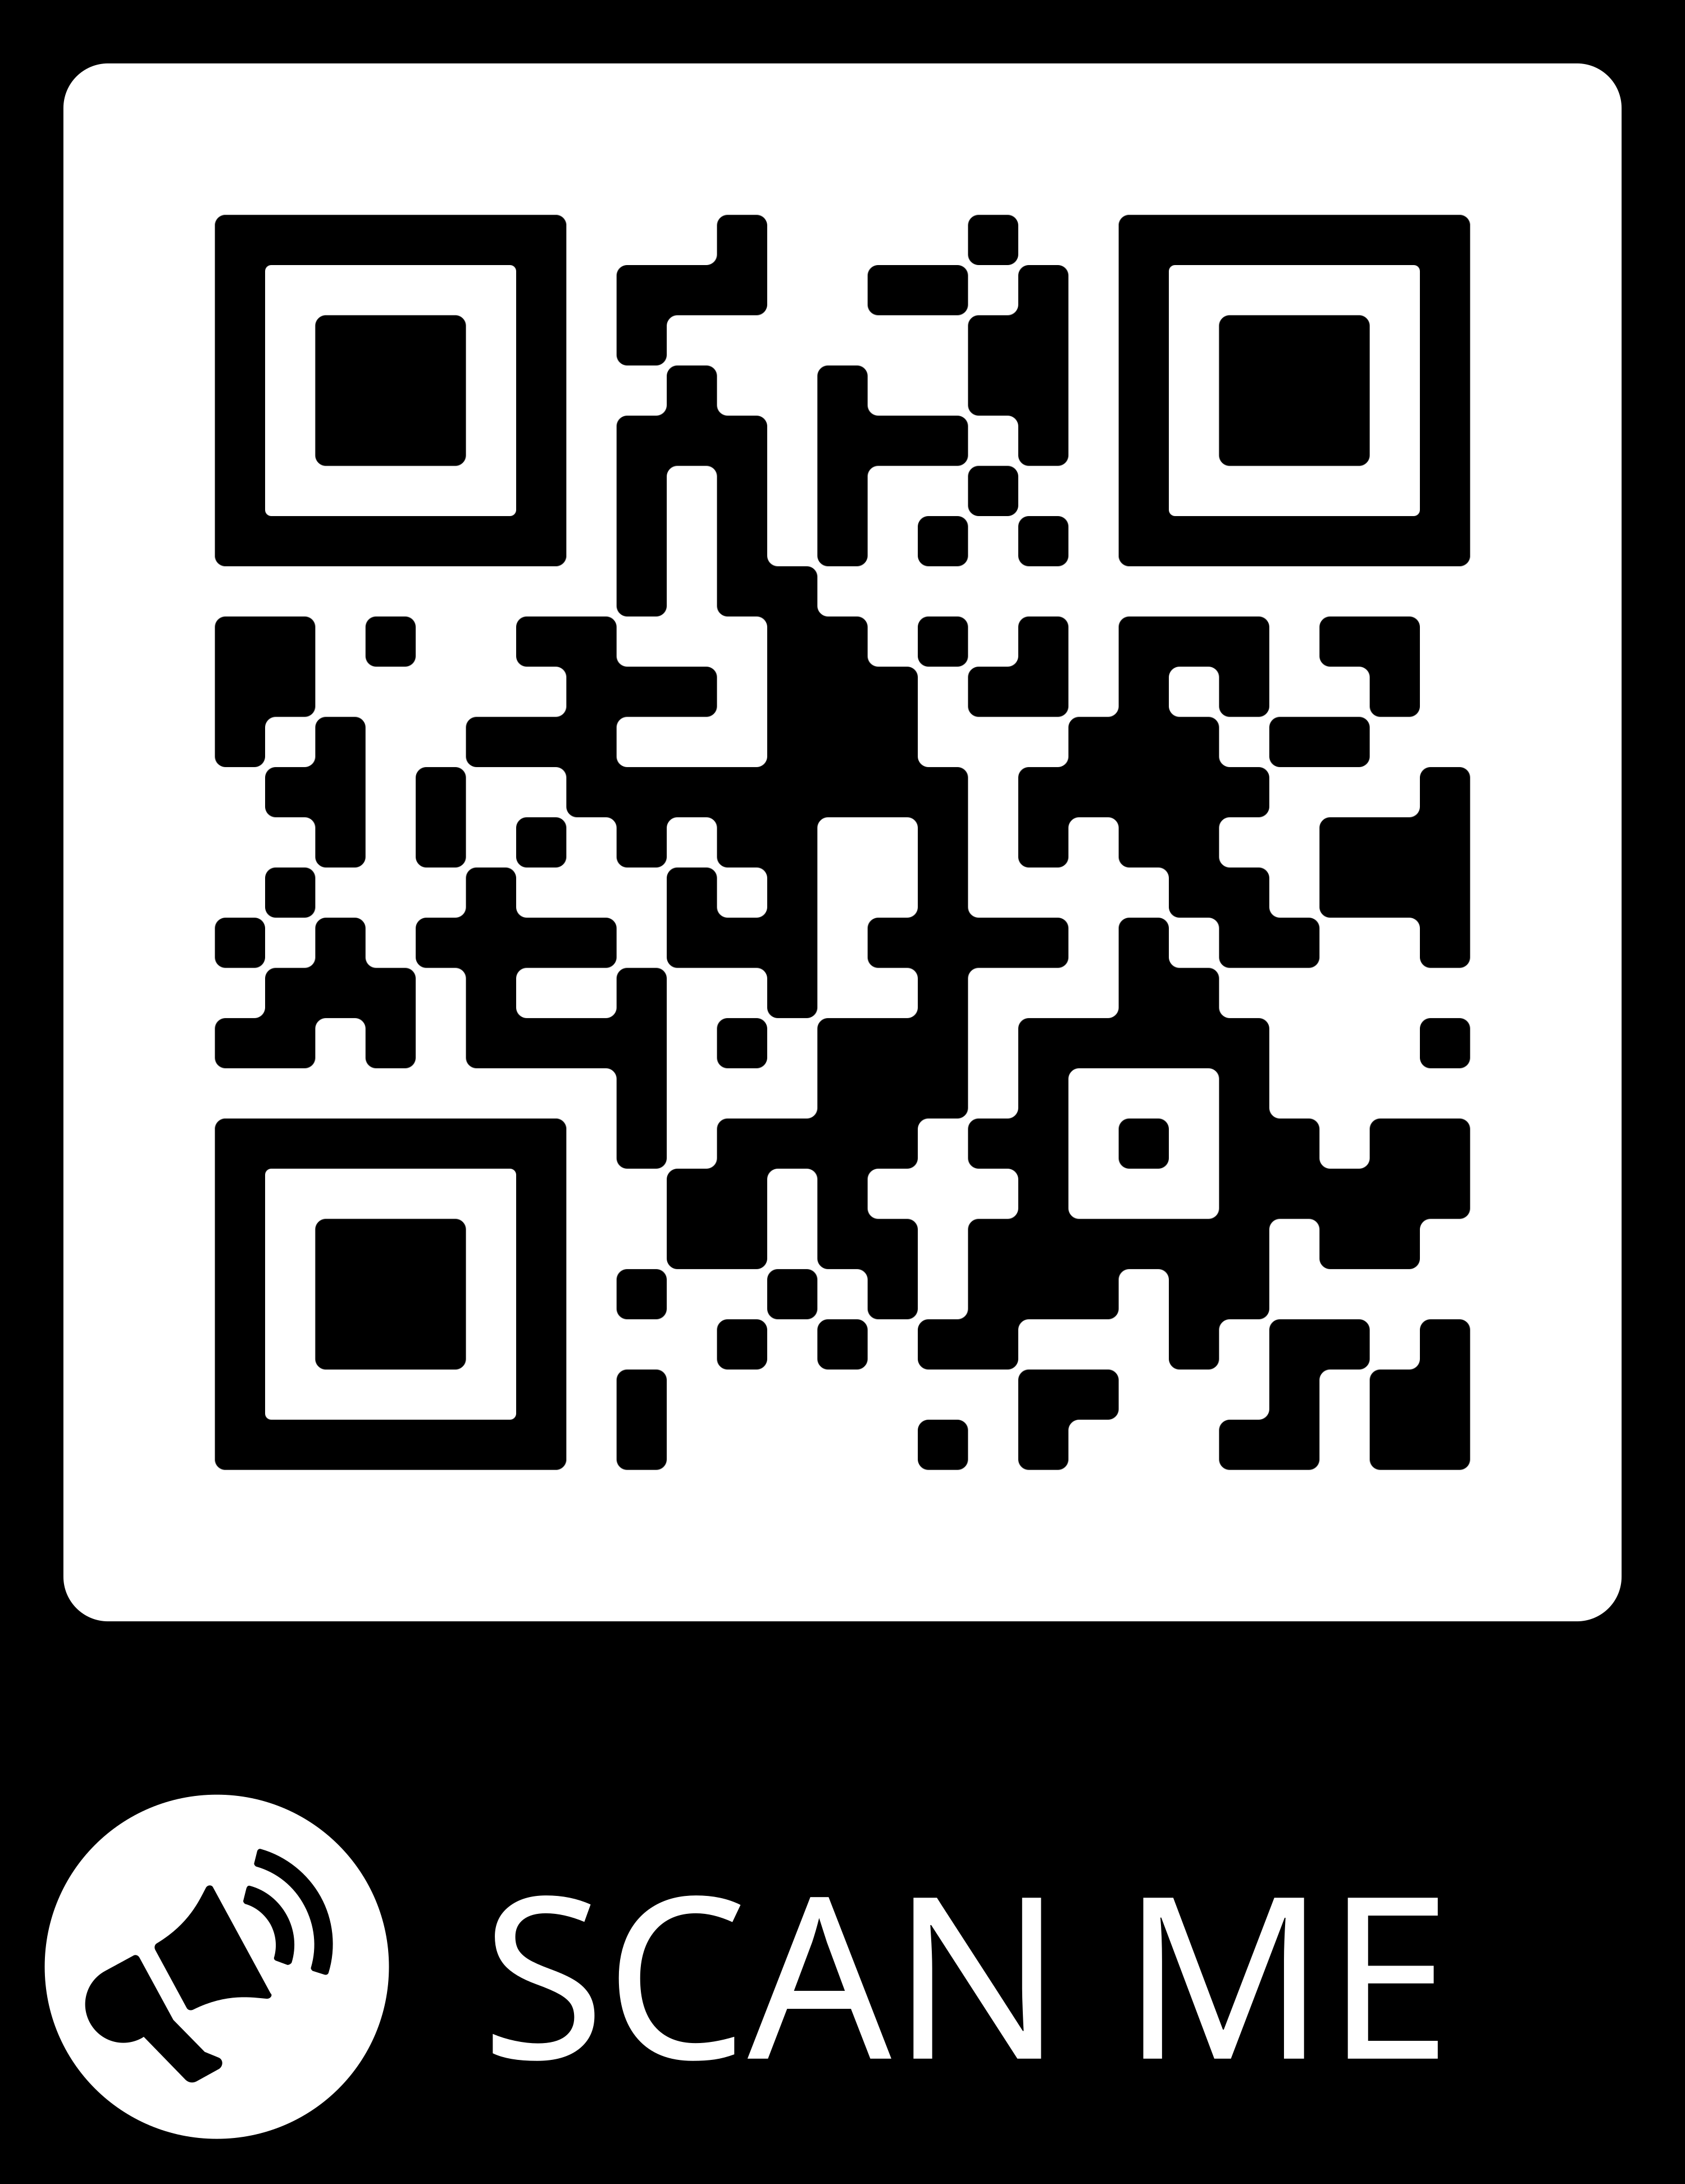

Slide 22
THANK
YOU!

