Slide 1
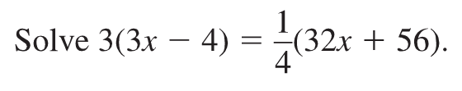
Bellwork

Slide 2
Parent Functions and Transformations
Section 1.1 and 1.2

Slide 3
Parent Function ( Take Note)
Functions that belong to the same family share key characteristics. The parent function is the most basic function in a family. Functions in the same family are transformations of their parent function.

Slide 4
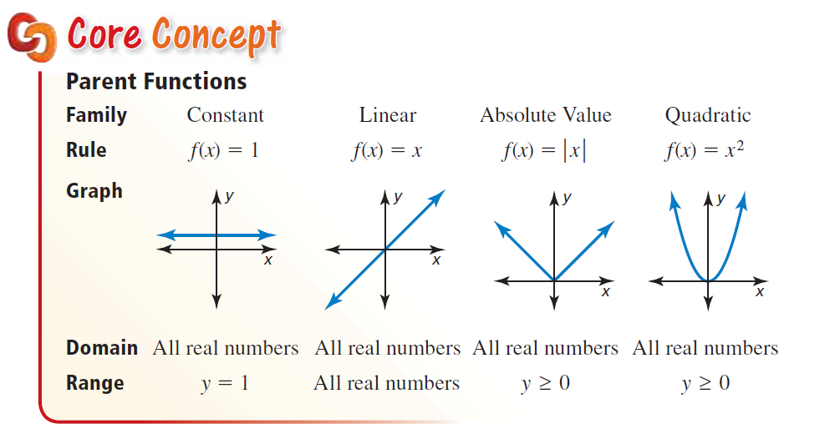
Take Note

Slide 5
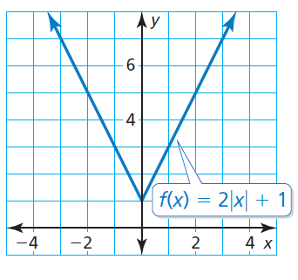
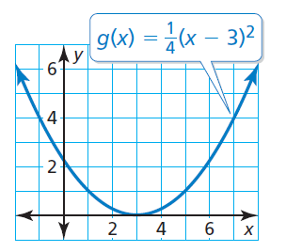
Identifying a Function Family

Slide 6
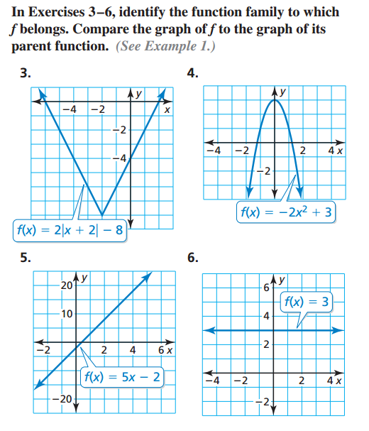
You Try:

Slide 7
Describing Transformations
A transformation changes the size, shape, position, or orientation of a graph. A translation is a transformation that shifts a graph horizontally and/or vertically but does not change its size, shape, or orientation.

Slide 8
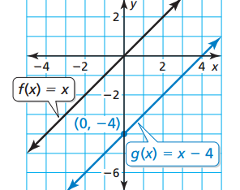
Graphing and Describing Translations
Graph g(x) = x − 4 and its parent function. Then describe the transformation.
Solution:
The function g is a linear function with a slope of 1 and a y-intercept of −4. So, draw a line through the point (0, −4) with a slope of 1.
The graph of g is 4 units below the graph of the parent linear function f.

Slide 9
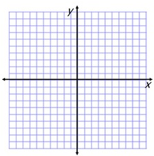
Graph the function and its parent function. Then describe the transformation.
1. g(x) = x + 4 2. f(x) = x − 6

Slide 10
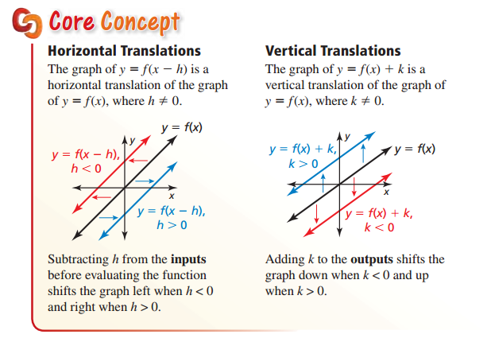
Take Note

Slide 11
You try:
3. f(x) = x − 5; translation 4 units to the left 4. f(x) = x + 2; translation 2 units to the right

Slide 12
Bellwork Let f(x) = 2x + 1.
a. Write a function g whose graph is a translation 3 units down of the graph of f.
b. Write a function h whose graph is a translation 2 units to the left of the graph of f.

Slide 13
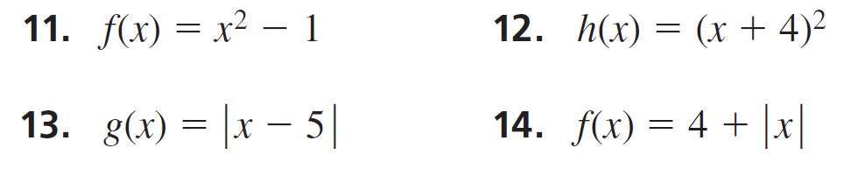
Let’s solve together

Slide 14
Reflection (Take Note)
A reflection is a transformation that flips a graph over a line called the line of reflection. A reflected point is the same distance from the line of reflection as the original point but on the opposite side of the line.

Slide 15
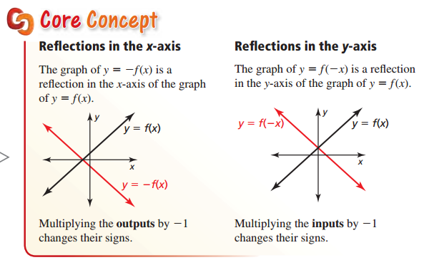
Reflections(Take Note):

Slide 16
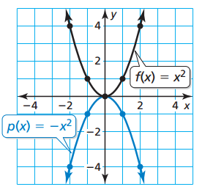
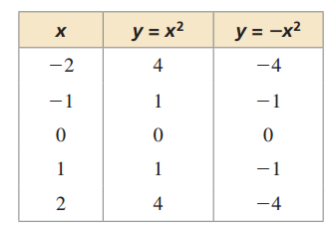

Graphing and Describing Reflections
Graph p(x) = −$x^{2}$ and its parent function. Then describe the transformation.

Slide 17
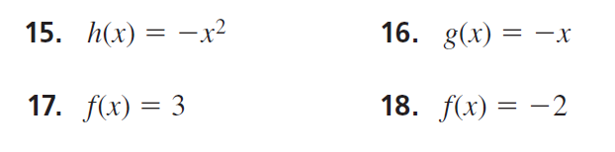
Graph the function and its parent function. Then describe the transformation.

Slide 18
Writing Reflections of Functions Let f (x) = ∣x + 3 ∣ + 1.
Write a function g whose graph is a reflection in the x-axis of the graph of f.
Write a function h whose graph is a reflection in the y-axis of the graph of f.

Slide 19
Vertical Stretch and Vertical Shrink (Take Note)
Another way to transform the graph of a function is to multiply all of the y-coordinates by the same positive factor (other than 1). When the factor is greater than 1, the transformation is a vertical stretch. When the factor is greater than 0 and less than 1, it is a vertical shrink.

Slide 20
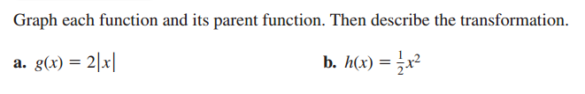

Slide 21
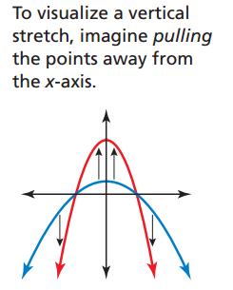
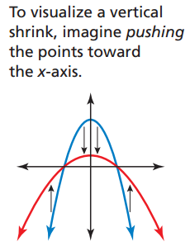

Slide 22
Bellwork
The total reimbursement (in dollars) for driving a company car miles can be modeled by the function
After a policy change, five more dollars are added on and then the total reimbursement amount is multiplied by 1.25. Describe how to transform the graph of f. What is the total reimbursement for a trip of 95 miles?

Slide 23
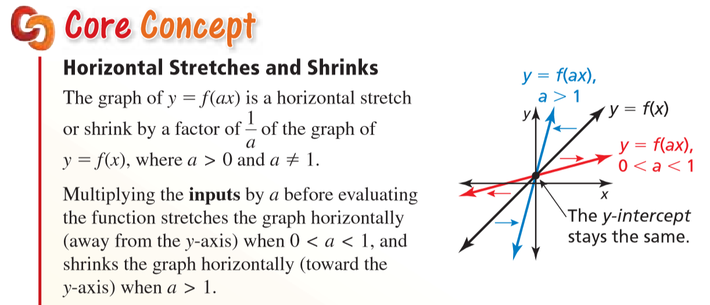
Take Note

Slide 24
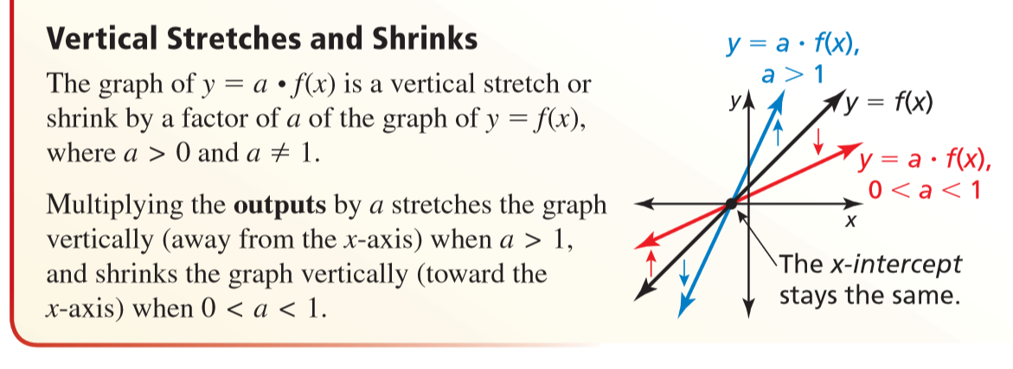
Take Note

Slide 25
Let f(x) = ∣x − 3 ∣ − 5.
Write
(a) a function g whose graph is a horizontal shrink of the graph of f by a factor of 1/3 , and
(b) a function h whose graph is a horizontal stretch of the graph of f by a factor of 2.

