Slide 1
Welcome Future Payne Families!
Payne received the A+ Award by the AEF.
Notes:
Paul

Slide 2
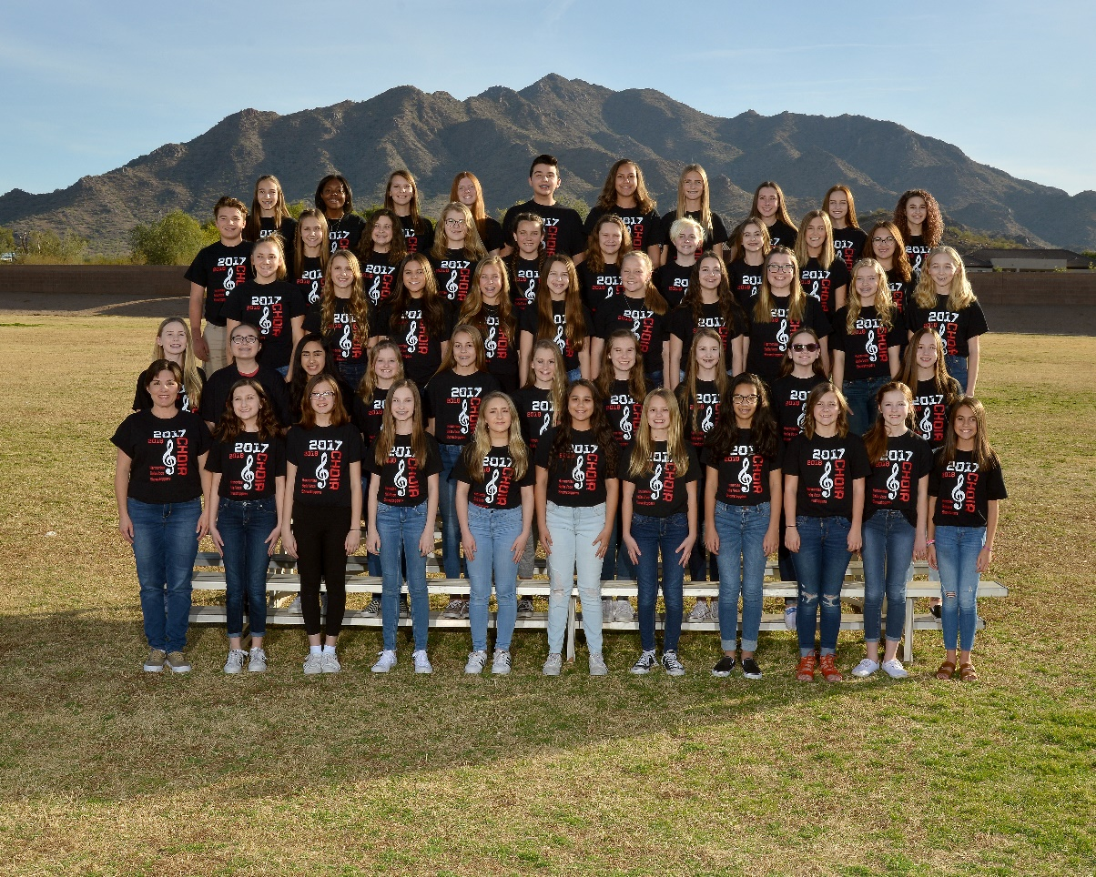
National Anthem performed by: PJHS Advanced Choir
Notes:
Paul

Slide 3
The Administration Team
Principal - Lisa Palella
Assistant Principal/Athletic Director - Michael Schultz
Dean – Amy Welch
Counselor IEP Services & Gifted Students, Mindfulness Room- Lisa Brown
7th Counselor 2023-24 - Aimee Smith
8th Counselor 2022-23 - Melanie Holan
Notes:
Paul introduces the team.

Slide 4
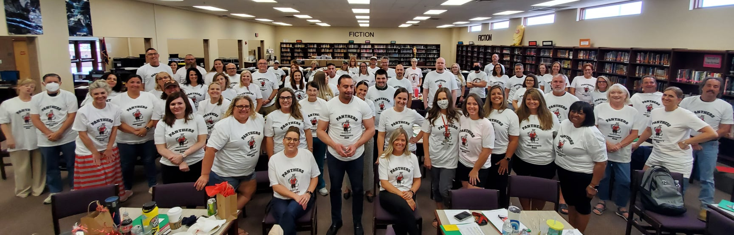
Our Staff
Notes:
Paul introduces the team.

Slide 5
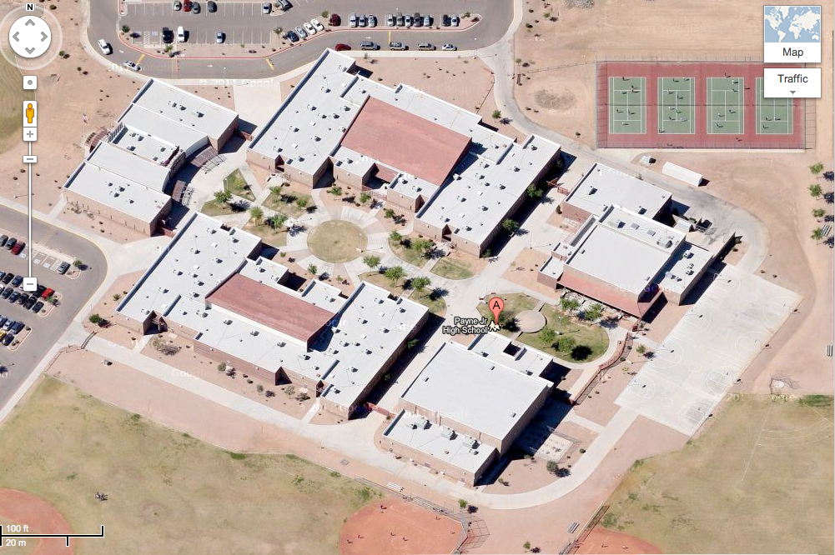
Parent drop off/pick up
Cafe / Music
B
OFFICE
7th Grade
E
C
8th Grade
Bus Lanes
D
Bike and
Skateboard
RACK
GYM
Notes:
Jayson - Show that the campus is split down the middle and quick virtual tour.

Slide 6
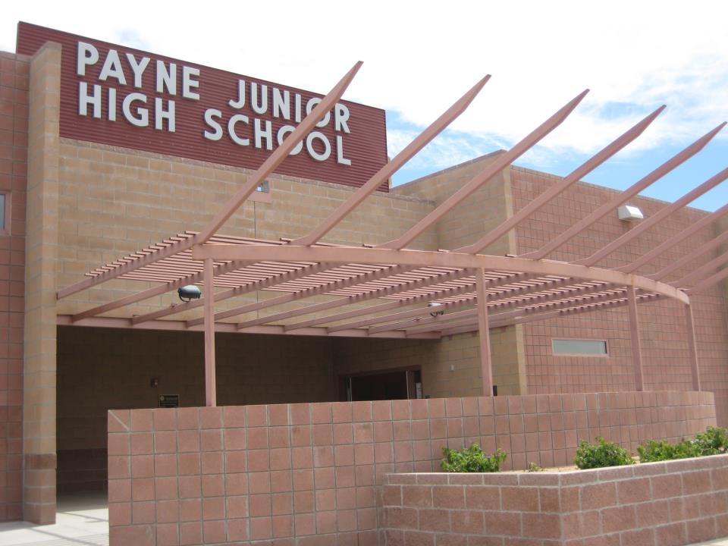
Topics We Will Cover Tonight
Teams
Schedule
Electives
Registration
Sports
Clubs
Special Programs
Odds and Ends
Notes:
Paul

Slide 7
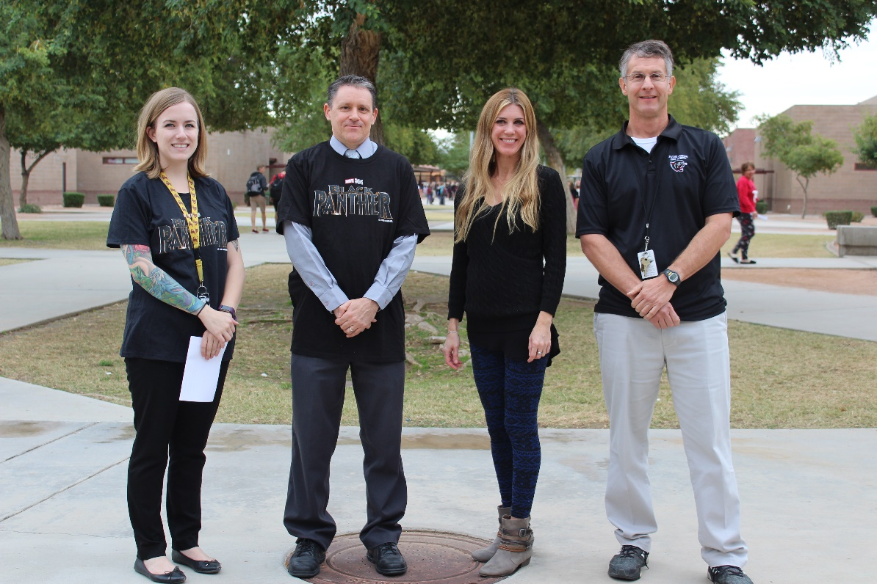
What is a Team?
A Team is a group of core teachers (Math, Science, Social Studies, and Language Arts) that work together with the same group of students.
The idea is to create small learning communities within the school.
4 Teams of 7th Grade
4 Teams in 8th Grade
1 CATS/Gifted Team (Chandler Academic Talented Students)
Team “702”
Notes:
Paul

Slide 8
1:1 Chromebooks
Each student will receive a Chromebook and charger
Devices will be handed out prior to school starting on Panther Day
Optional protection plan is available for purchase
Devices will go back and forth with students each day

Slide 9
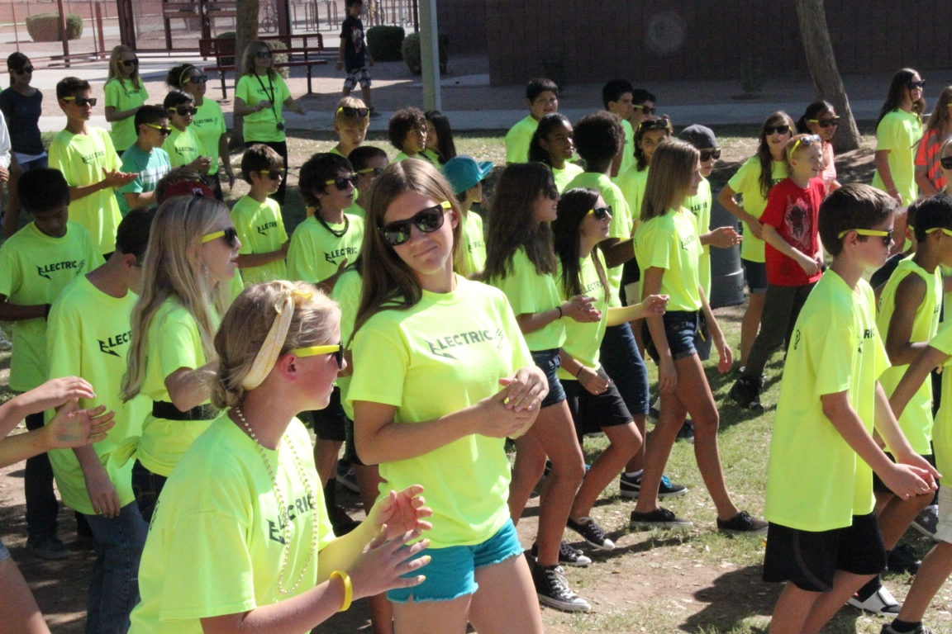
Benefits of Teams
Sense of belonging for students
Consistent, clear expectations
Coordinated work-load
Achievement and recognition
Streamlined communication
Notes:
Paul

Slide 10
What will your child’s day look like at PJHS?
Period | Day 1 | Day 2
1 | Math | Math
2 | Science | Science
3 | Academic Progress/Lunch | Science
4 | Social Studies | Social Studies
5 | Art | PE
6 | ELA | ELA
All students go to six class periods a day including four core classes: Math, Science, Language Arts, and Social Studies.
One period will be electives based on a Day 1/Day 2 schedule.
(Sample Schedule)
*Lunch information on next slide
Notes:
Joyce

Slide 11
When is Lunch?
3rd Hour | 3A | 11:22 - 11:52 | Lunch
 |  | 11:56 - 12:30 | AP
 |  | 11:22 - 11:56 | AP
 | 3B | 12:00 - 12:30 | Lunch
 | passing | 12:30 - 12:34
4th Hour | 4C | 12:34 - 1:04 | Lunch
 |  | 1:08 - 1:42 | AP
 |  | 12:34 - 1:08 | AP
 | 4D | 1:12 - 1:42 | Lunch
Notes:
Joyce

Slide 12
Electives
Year Long Courses | Semester Courses
Physical Education | Engineering PLTW Design & Modeling
Percussion Ensemble | Engineering PLTW Automation & Robotics
Cadet Band | General Art
Cadet String Orchestra | Ceramics
Choir (Beginning, Show & Advanced) | Oral Expressions
Spanish (High School level) | FACS (Family and Consumer Sciences)
Yearbook (Application Required) | Technology 101
Media Production | Computer Science Discoveries
Teacher/Office Aide (8th only) | Digital Media
 | Semester PE
Notes:
Joyce

Slide 13
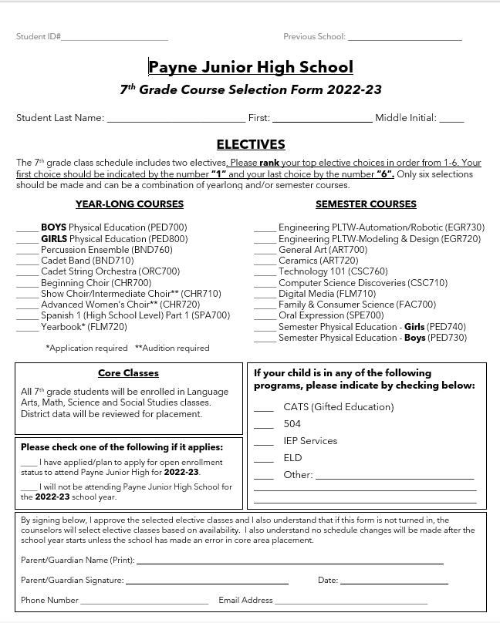
Registration
Notes:
Counselor

Slide 14
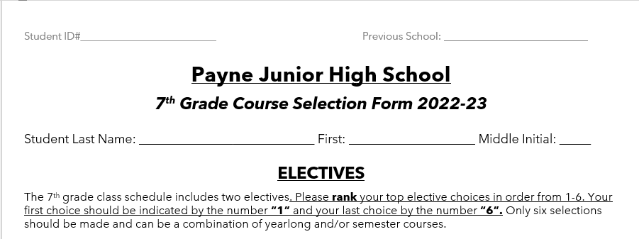
Course Selection Form
Last Name
First Name
Gifted testing done through
the IRC.
Honors placement based on
State Assessment Results.
Notes:
Counselor

Slide 15
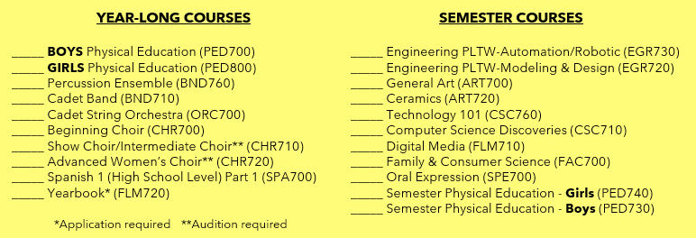
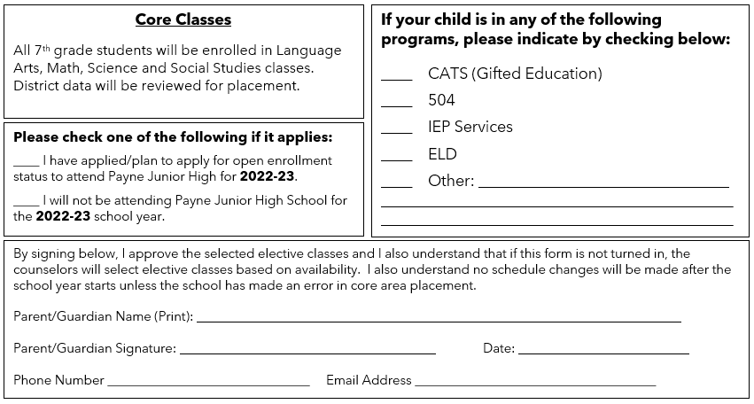
Elective Choices
1
Rank your choices 1- 6
3
4
5
2
6
Parents, please sign!
Notes:
Counselor

Slide 16
Can my child’s schedule be changed?
Schedule corrections can be made in the following circumstances:
A computer error in the student’s schedule.
A needed change in the curriculum level of instruction.
A doctor’s excuse from PE for health reasons.
Notes:
Counselor

Slide 17
Visiting Our 2023-24 Feeder Schools
 | Jan. 17 | Jan. 18 | Jan. 19 | Jan. 20
RICE
CARLSON
RYAN
HALEY
RIGGS
WGA
NAVARETTE
PATTERSON
Notes:
Paul

Slide 18
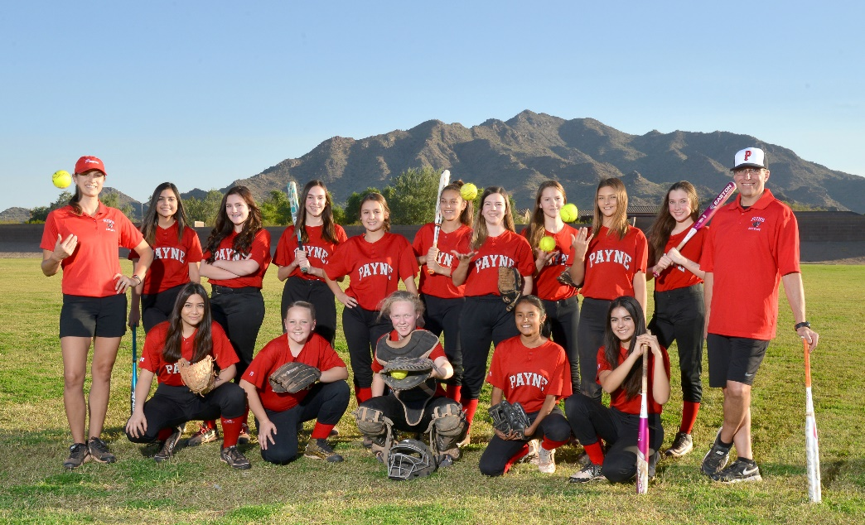
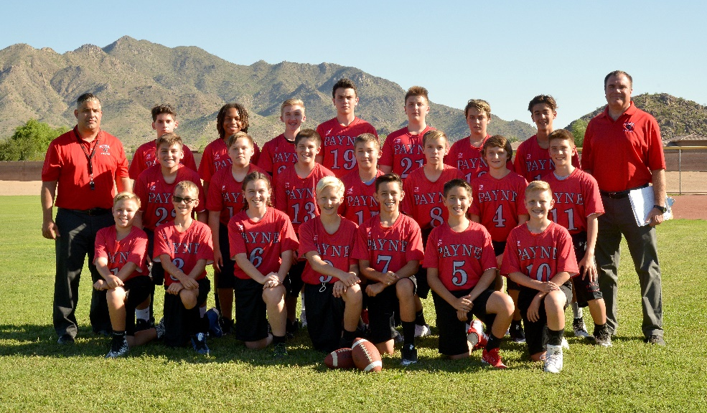
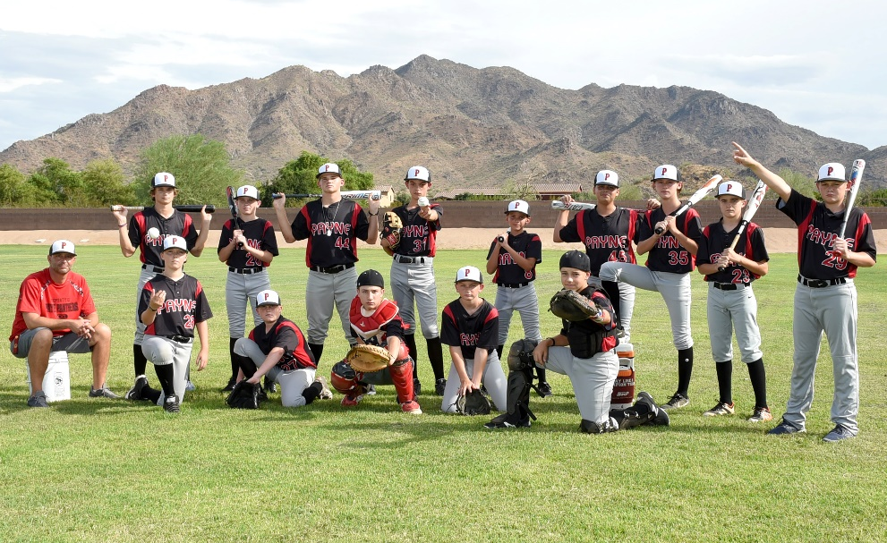
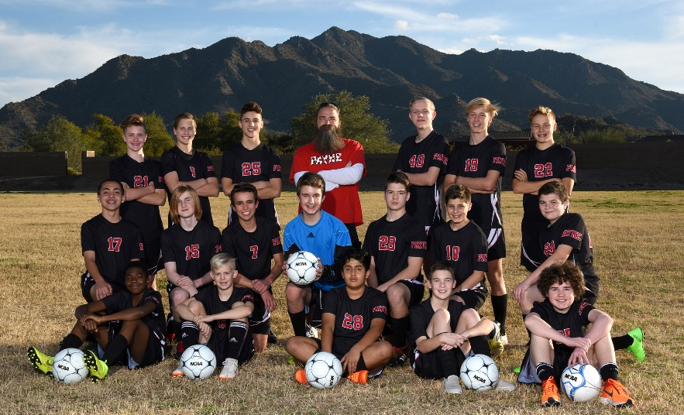
PJHS Athletics
Notes:
Paul

Slide 19
EVC (East Valley Conference)
Notes:
Paul

Slide 20
1st Season | 2nd Season | 3rd Season | 4th Season
Boys Baseball | Boys Basketball | Boys Soccer | Boys Volleyball
Girls Volleyball | Girls Softball | Girls Basketball | Girls Soccer
Co-ed Wrestling (Non-Cut)* | Cross Country (Non-Cut) | Co-ed Flag Football* | Track & Field (Non-Cut)
Cheer (Try-outs 1st Season only) | Cheer | Cheer
* Season change for 2023-24
Notes:
Paul

Slide 21
2021-22 EVC CHAMPIONSHIPS
Golf Club
Wrestling
7th Girls Basketball
7th Boys Basketball
Notes:
Paul

Slide 22
Athletic Clearance
All student athletes MUST be registered online at Aktivate/Register My Athlete starting April 1, 2023 for the 23-24 school year. Physical
packets should be completed after March 1, 2023.
Please visit our website, Payne Jr High Athletics for ALL necessary paperwork as well as instructions on how to register.
Notes:
Paul

Slide 23
Clubs
GSA Club | Card Club | Podcast Club
Golf Club | Creative Writing Club | National Jr Honor Society
Book Club | Mountain Bike Racing Club | Drama Club
Lego Robotics | Agricultural Club | Panther Pals
ASL Club | Teck Deck Club | Comic Book Club
Anime Club | Aviation Club | Builders Club
Notes:
Lisa

Slide 24
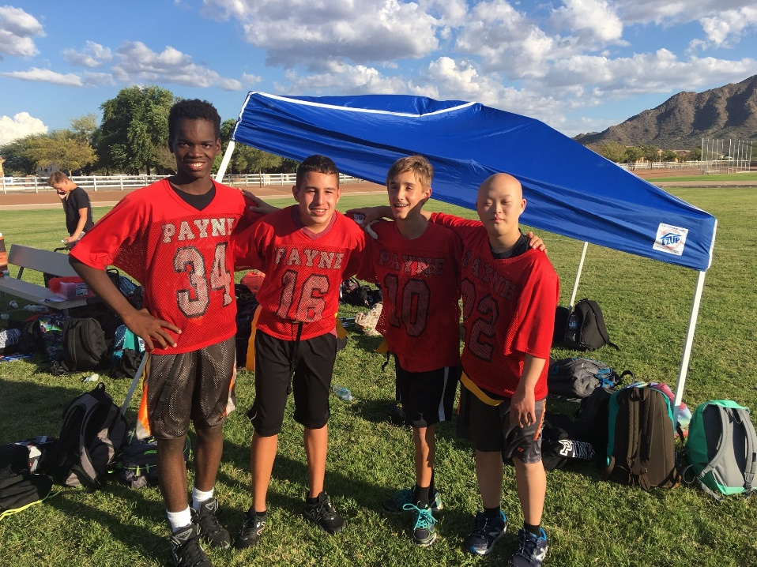
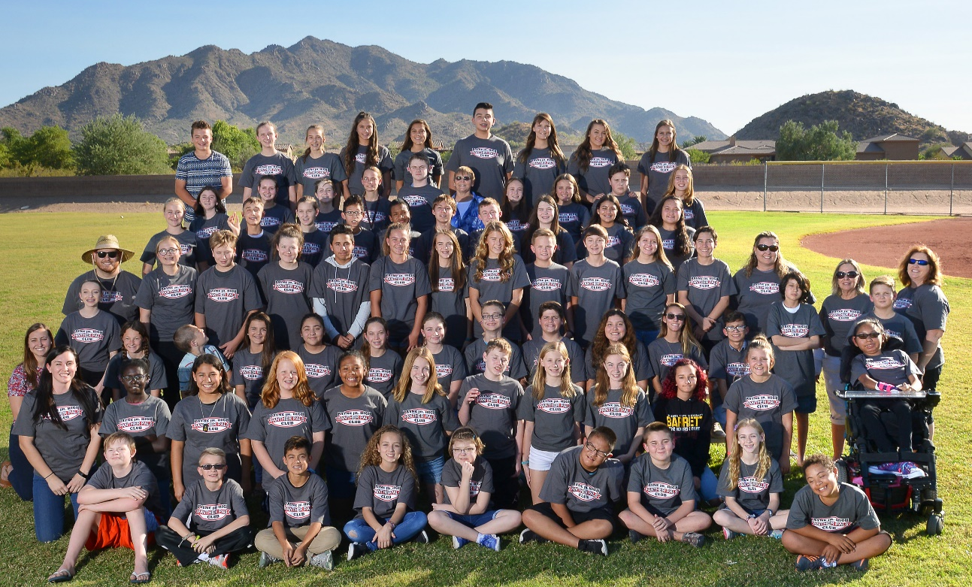
Special Programs at PJHS
Homework Hub
Service/Fundraisers
Panther Pals
Unified Sports
Academic Progress (for all)
Notes:
Lisa

Slide 25
Open Enrollment – January 9, 2023 cusd80.com/secondaryopenenrollment email completed application to: Bautista.Karina@cusd80.com

Slide 26
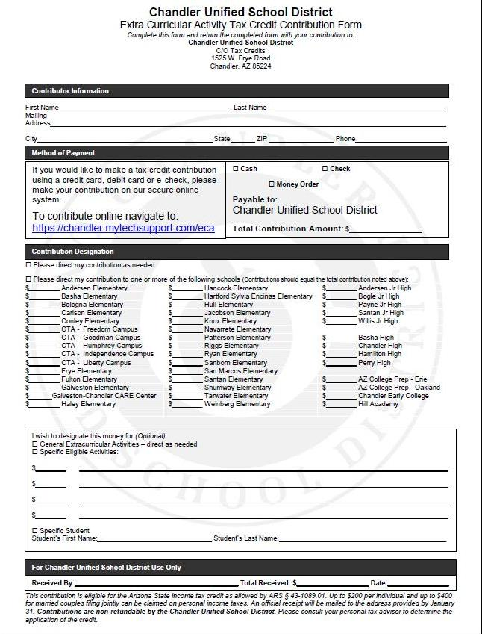
How can you support Payne?
Tax Credit
(2022 donations can be made until April 15, 2023)
CEF
Site Council
Booster Club
Volunteers
Notes:
Paul

Slide 27
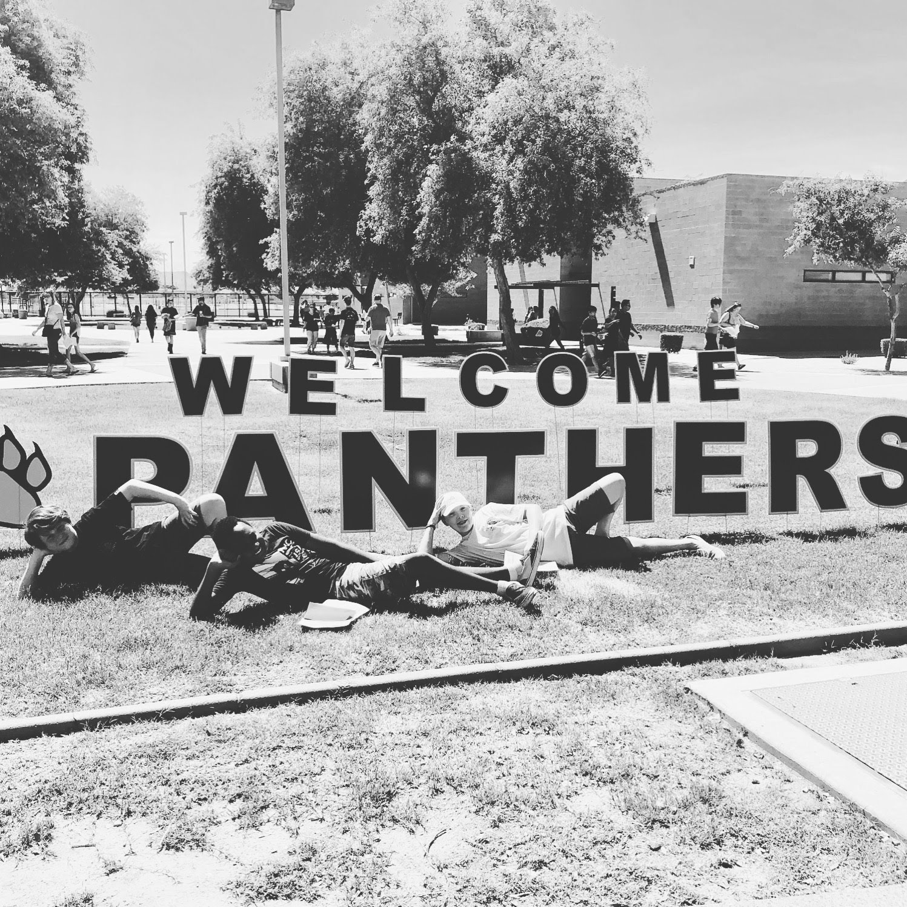
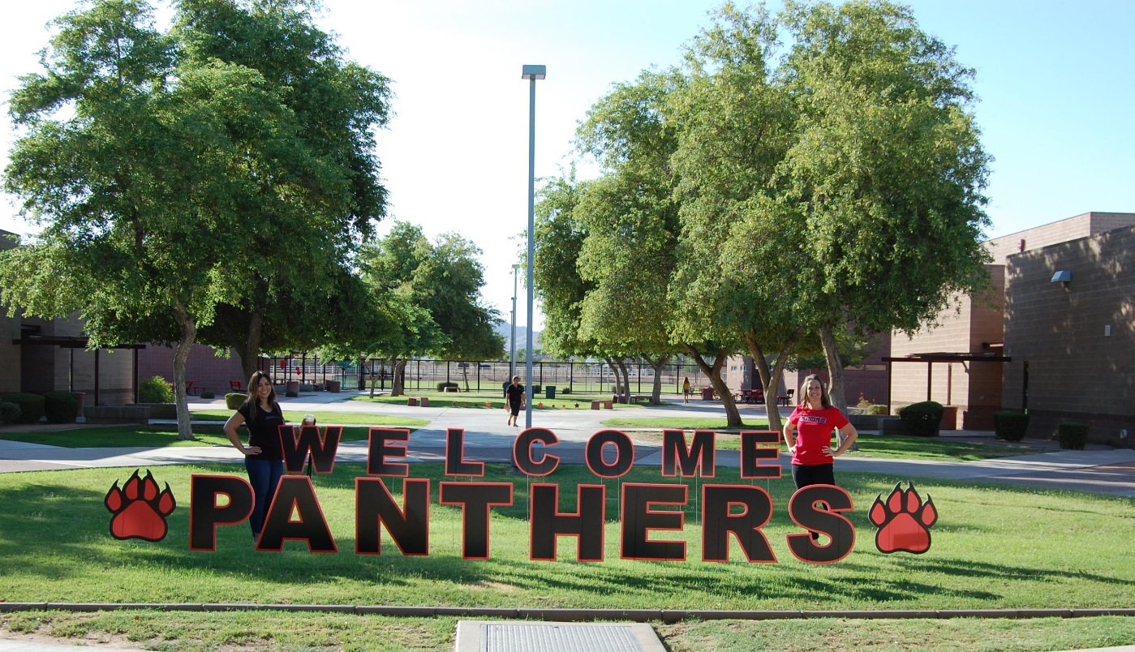
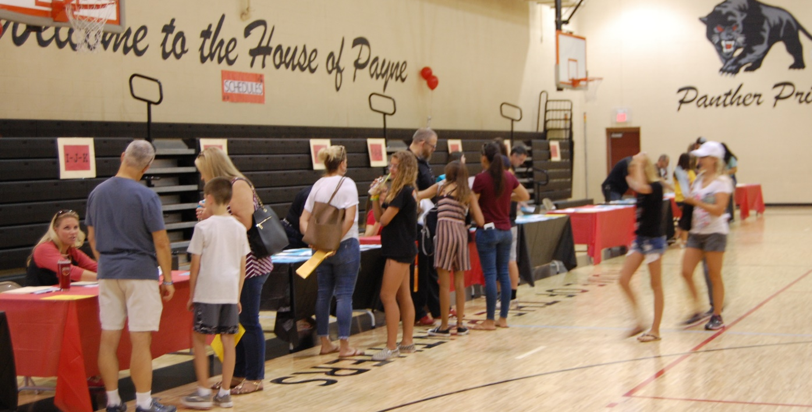
Panther Day 7/17/2023
Notes:
Paul

Slide 29
Social Media
@Payne_Jr_High
@Payne_Athletics
Paynejrhigh
Payne_stuco
Payne Junior High
pjhsboosterclub
Notes:
Paul

Slide 30
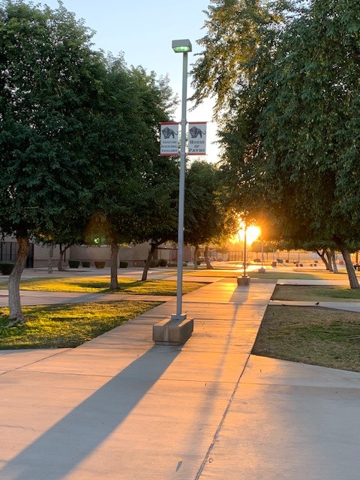
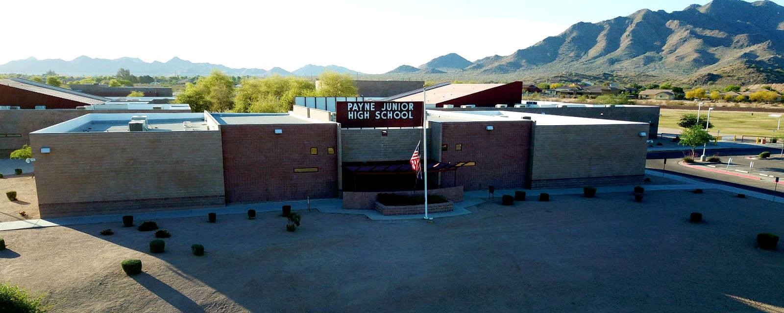
Thank you!
We look forward to seeing you next year!
Notes:
Paul

Slide 31
Check out our Campus:
Student Council – B4 | Yearbook – E36
Builders Club – B9 hallway | Mountain Bike Club – E37
IEP Services/Panther Pals – B15 | Drama Club – E34
NJHS – E29 | Technology 101 – E35
Social Studies/Civics Dept. – B26 | Language Arts Dept. – E43
Science Dept. – E37 | Math Dept. – E44
Enrollment Information - Front Office | Athletics – Media Center
Performing Arts – Cafeteria (on the stage) | Booster Club – Media Center (selling Payne Gear)
Notes:
Paul

