Slide 1
Economics
Mrs. Aboud
Curriculum Night 2023-2024

Slide 2
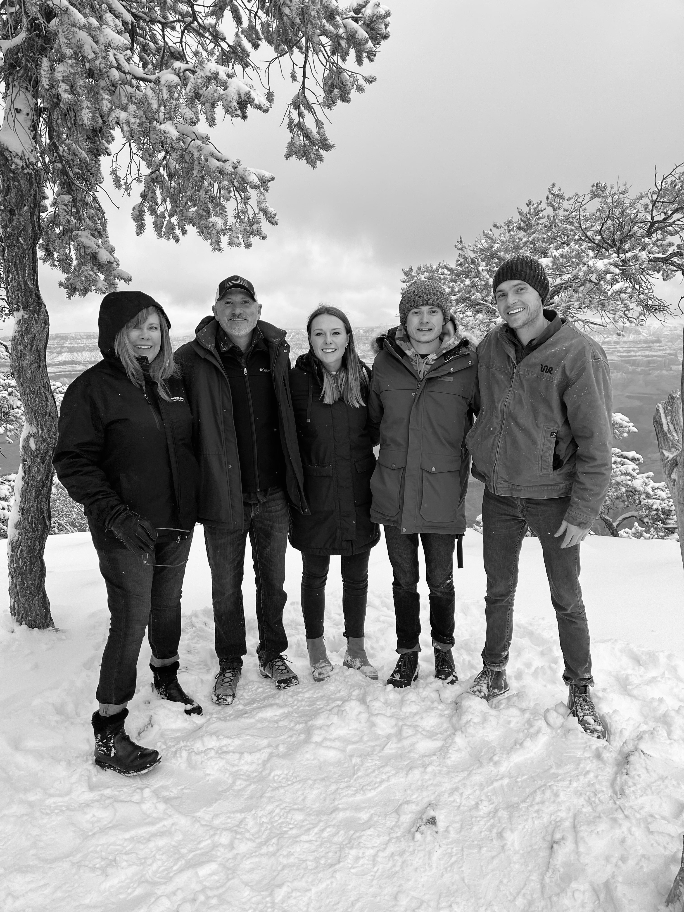
About Me
Bachelors Degree – Economics
Masters Degree – Education
17th year teaching for CUSD
Previously, I worked as a Manufacturer’s Representative selling electrical and lighting products
2 Sons (ages 25 and 28) – Both attended Chandler Schools

Slide 3
What will we learn?
Basic Economic Concepts – scarcity, marginal benefits and costs, economic systems, incentives, free enterprise.
Supply and Demand – buyers, sellers, price floors and ceilings, surplus and shortage, equilibrium and efficiency
Personal Finance – budgets, investments, debt, loans, mortgages, career choices, credit, saving, assets and liabilities
Macroeconomics – GDP, inflation, unemployment, poverty, government taxation and spending, fiscal policy, monetary policy, Federal Reserve
Global Economy – trade, tariffs, comparative and absolute advantage, imports and exports, exchange rates, specialization, and globalization

Slide 4
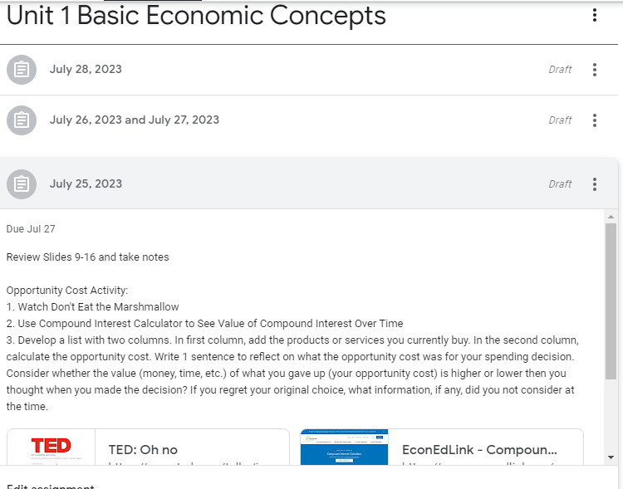
Google Classroom
Students can access the curriculum including PowerPoints, video clips, and assignments, etc. This is especially beneficial when a student is absent.

Slide 5
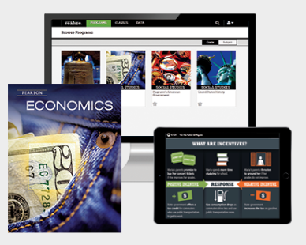
Textbook

Slide 6
Casteel Stock Market Madness
Students get the opportunity to trade on a live platform with $100,000 in virtual money.

Slide 7
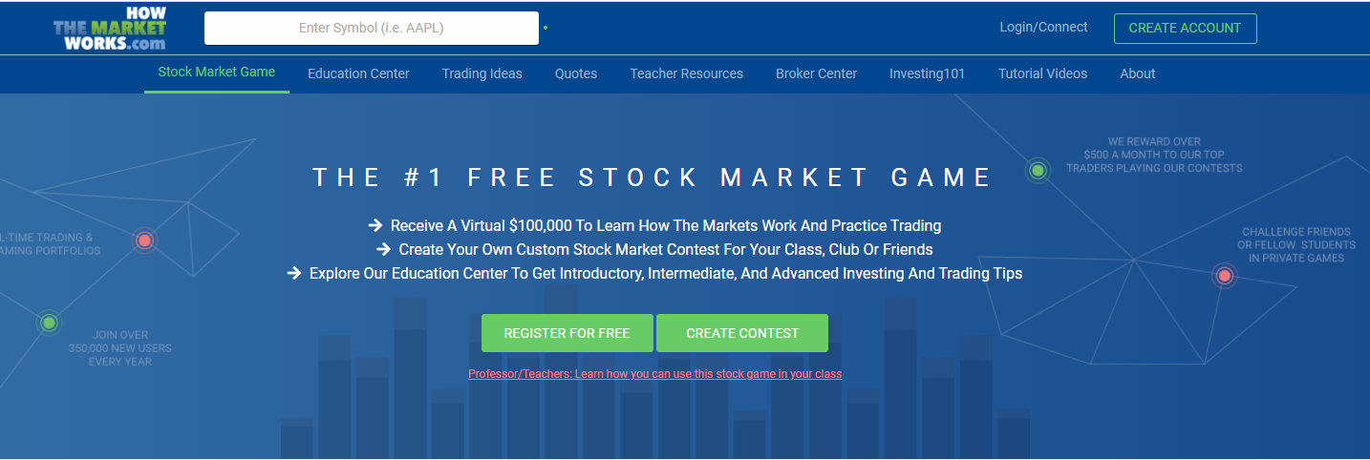
Students given $100,000 virtual money
Mrs. Aboud and Mr. Daniels’ classes are all part of the same group
Real trading platform TD Ameritrade

Slide 8
Personal Finance Seal
https://www.cusd80.com/Page/112247
Complete all social studies classes with a B or better
Complete EVERFI curriculum and pass assessments
Extracurricular or co-curricular Program
How the Market Works
College and Career Readiness
FASFA or college and career plan

Slide 9
Grading Policy Economics is required for high school graduation, so it is essential that students complete all assignments and assessments.

Slide 10
Thank you for reviewing the PowerPoint
Thank you for attending.
If you have further questions,
Please feel free to contact me at:
480-424-8148
aboud.julie@cusd80.com

