Slide 1
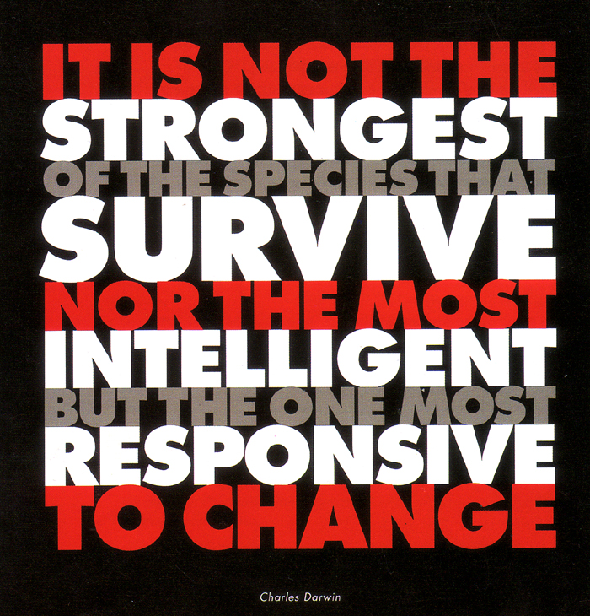

Slide 2
Natural Selection
The unequal survival and reproduction of organisms due to environmental forces, resulting in the preservation of favorable adaptations.
It is a two step process:
1. The Production of variation in a population
2. Non-random aspects of survival and reproduction

Slide 3
Natural Selection is a two step process:
Step One: The Production of Variation. (Chance)
Mutations
Meiosis:
recombination due to crossing-over in 1st division
random movement of chromosomes in 2nd division
Random mate selection & fertilization
Do we see variation within different wild species ?
Step Two: Non-random aspects of survival and reproduction
Superior success of certain phenotypes
Nonrandom mate choice

Slide 4
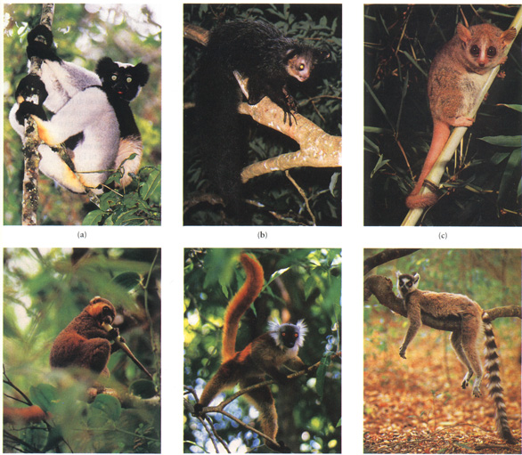
Lemurs of Madagascar

Slide 5
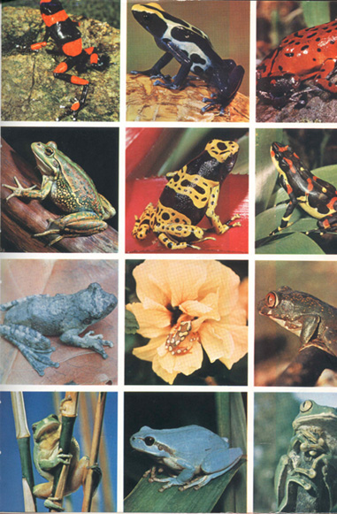
Amazonian Frogs

Slide 6
Humans select traits for dogs, pigeons and other animals when they breed them.
Bred Pigeons came from a single original species
Who selects the traits for wild plans & animals?

Slide 7
NOBODY!!
There is no agent involved in natural selection.
Natural selection is a process of elimination
INDIVIDUALS THAT HAVE TRAITS THAT ARE BEST ADAPTED FOR THE CURRENT ENVIRONMENT ARE THE ONES THAT SURVIVE TO BREED AND PASS ON THEIR GENES TO THE NEXT GENERATION.
Organisms not possessing the beneficial traits either die or don’t have as many offspring.
Natural Selection is Survival of the fittest

Slide 8
Natural Selection is a mixture of both Chance and necessity
Natural Selection is not goal directed. It does not have a long term goal.

Slide 9
What acts as a selection pressure on a population?
Competition for food
Competition for a mate
Changes in the environment
Predators
Parasites
Example of Natural Selection in Action: Monarch / milkweed
Card game
Video of Darwin’s Finches

Slide 10
Main Types of Selection Pressures
Directional Selection
Natural selection favors one extreme of the population for that trait
often happens when environment changes in a consistent way- e.g.climate gets colder.
Disruptive Selection
Natural selection favors both extremes selected
Causes species to diverge
Stabilizing Selection
Natural selection favors the average for population selected
Sexual Selection

Slide 11
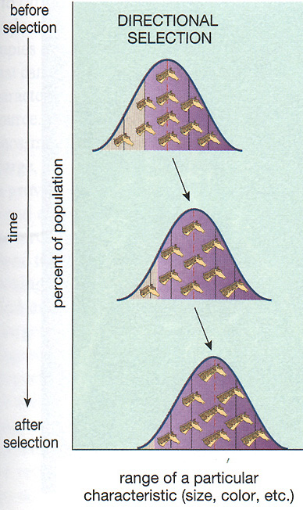
Directional Selection
Neck of Giraffe
Antibiotic resistance of bacteria
Moth color (melanin)
Camouflage/Mimics
Many sexually selected traits

Slide 12
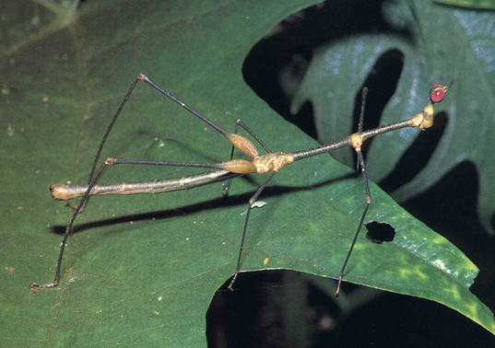
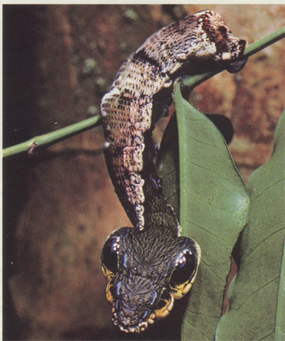
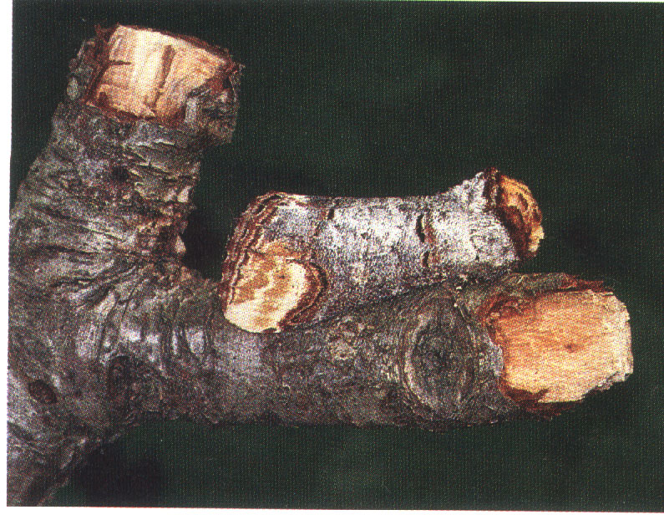
Directional Selection: Mimicry (mimic environment)

Slide 13
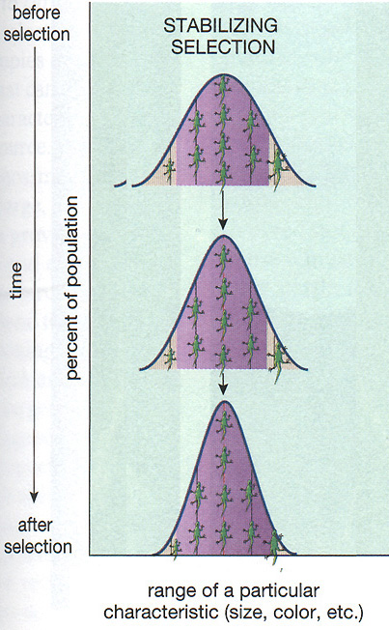
Stabilizing Selection
When the extremes of the trait aren’t as well suited
Examples
bird clutch size
Elk Antlers size
Giraffe neck length
Tail length in birds

Slide 14
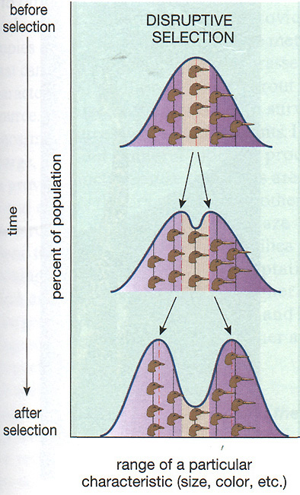
Disruptive Selection
Causes divergence within the species
Occurs when two different types of resources in one area
Results in specialization for each branched group
May lead to formation of new species
E.g. Darwin’s Finches

Slide 16
Examples of selection pressures...
Predators - variants with adaptations allowing them to escape predators have more offspring
- e.g. speed, defensive weapons, camouflage, mimicry
Prey/Food - variants with adaptations allowing them to obtain food have more offspring
- e.g. Speed, senses for finding prey/food, weapons for killing prey or obtaining food, camouflage for stealth
Climate - those who can survive new climate best have more kids
- e.g. ice age, change in climate due to migration.
Mates - variants with adaptations allowing them to attract a mate to have offspring
- e.g. strong, attractive, good provider

Slide 17
Example #1: Escaping Predation Peppered Moth (see video clip)
Early trees had light-colored bark
Only the light-colored moths survived. Selection was for less melanin.
After industrialization, the tree bark was darker.
Only the darker colored moths now survived. Selection was for more melanin.
New info on the Pepper Moth experiment

Slide 18
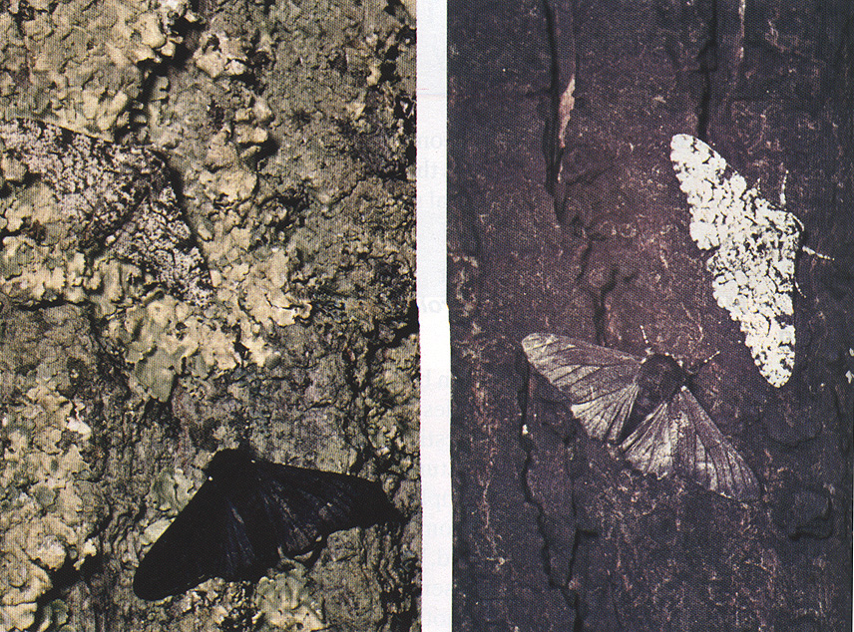

Slide 19
Example #2: Obtaining Food
The neck of the Giraffe
Co-evolution with Acacia Trees
Selection pressure is source of food
The Red Queen Hypothesis...

Slide 20
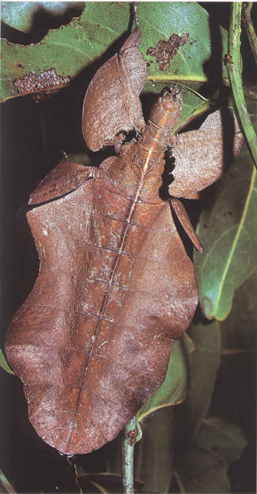
Example #3
The leaf bug
The selection pressure is predators
It’s strategy is to mimic a leaf
Pray Mantis Camouflage

Slide 22
Camouflage, Mimicry & Decoys
Purpose - escape from predators, sneaking up on prey
Camouflage - directional selection favors individuals who most resemble environment
Mimicry - directional selection can favor individuals who most resemble something harmful, unappetizing, or non-threatening
Decoys - directional selection can favor individuals who
Use lures or decoys to attract other animals to be eaten or help them unwittingly

Slide 23
Other Mimicry Examples
1. Viceroy and Monarch butterflies (see video)
2. Walking stick
3. Crab with rock garden on shell
4. Cobra mimic
5. Angler Fish with lure
6. Orchid and wasp

Slide 24
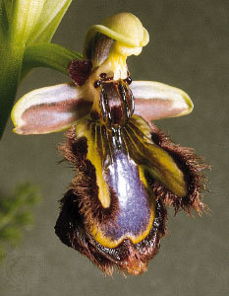
The coloring so closely resembles that of the female wasp Colpa aurea that males of the species are attracted to the flower and pick up pollen during their attempts at copulation.
It also produces pheromones to attract male wasps.
Timing is also important.
The labellum of Ophrys speculum Orchid.

